Slide 1
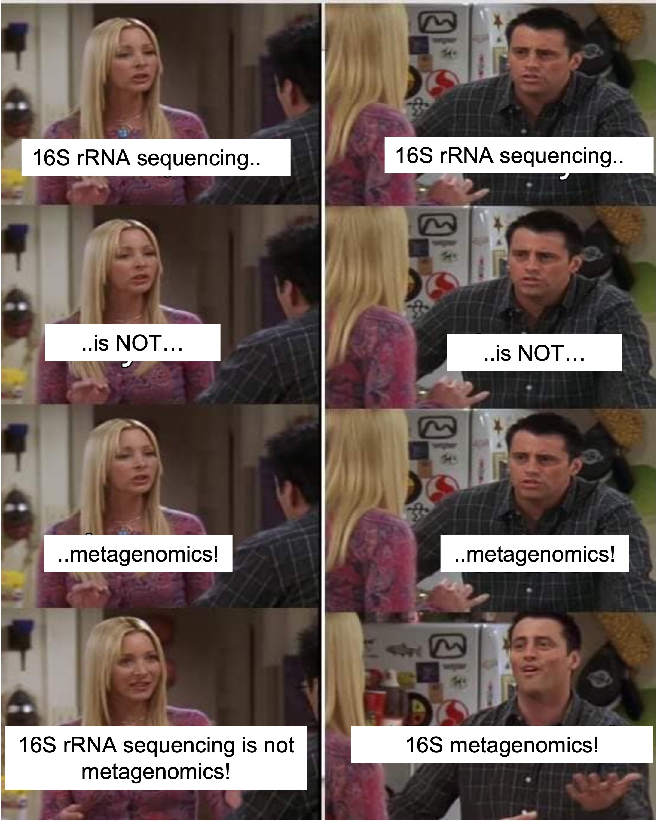
16S rRNA: data analysis
Dr. Natalia Zajac
Metagenomics, 12.2024

Slide 2
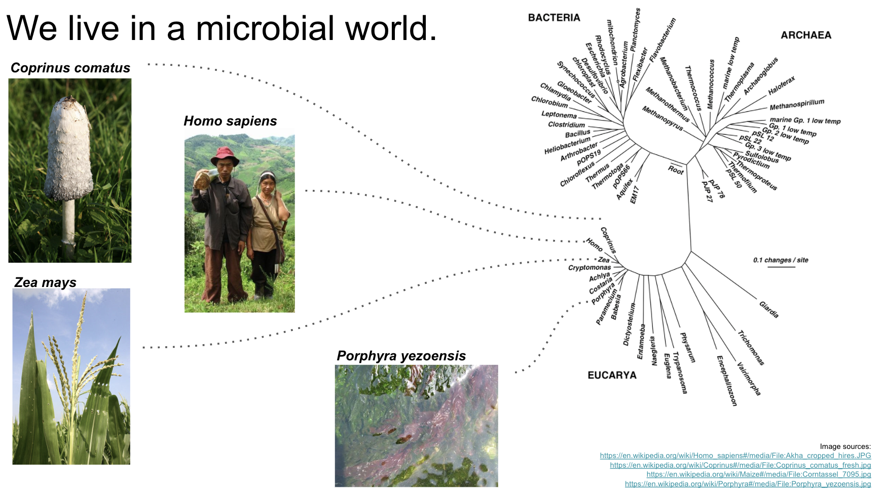
Microbes are everywhere
QIIME2 tutorial workshop

Slide 3

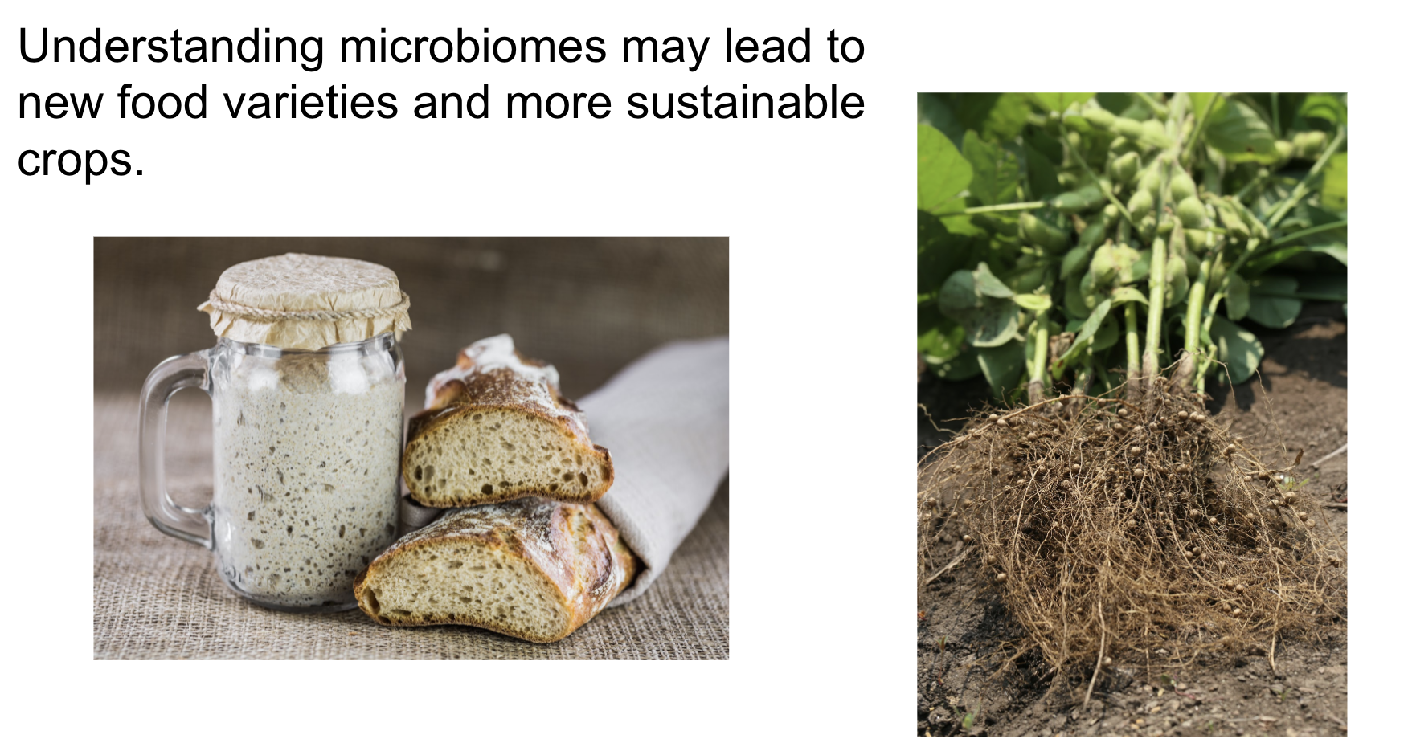
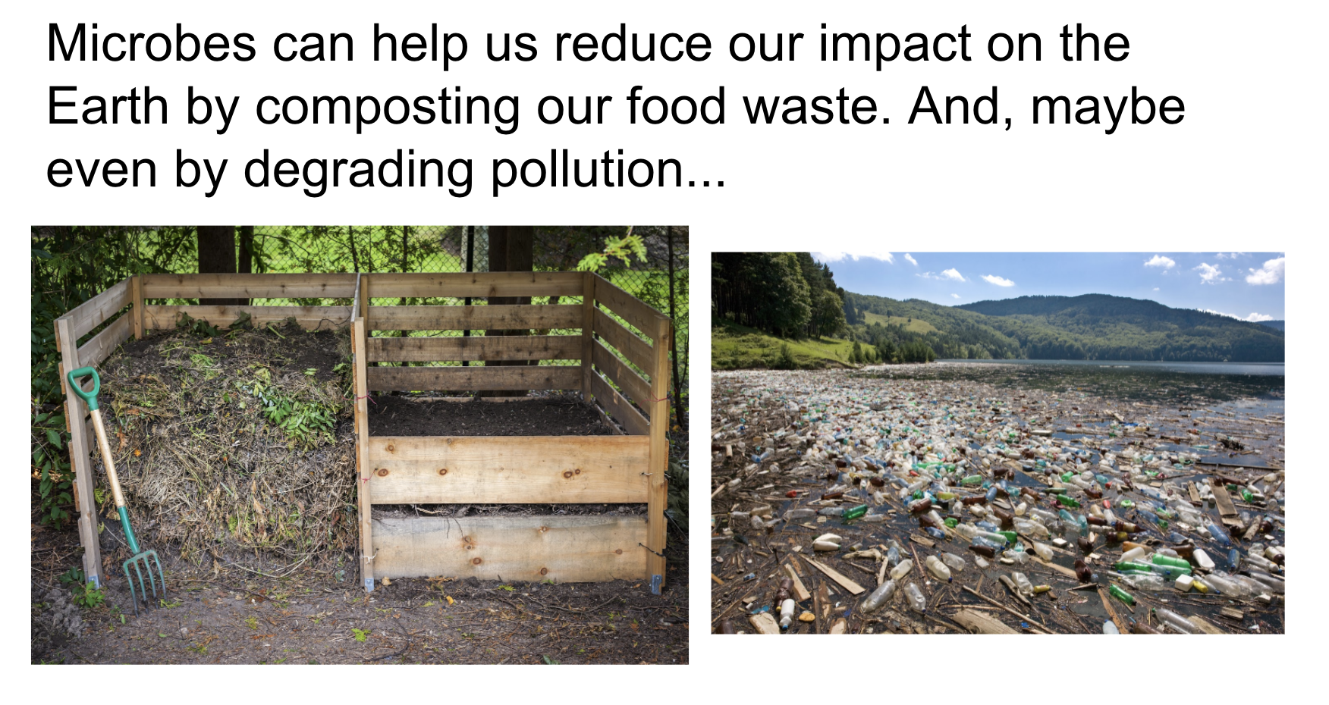
Applications
QIIME2 tutorial workshop

Slide 4
Outline
Main goals
Main challenges
Approaches
Databases
File format

Slide 5
Ribosomal RNA
Present in every organism
Essential for protein translation
Relatively conserved
Most widely used
16S (Bacteria)
18S (Eukaryotes)
ITS (Fungi) - Nuclear ribosomal internal transcribed spacer
Multiple markers combination also possible
PhyloSift, MetaPhlAn2

Slide 6





16S example workflow and associated challenges
Reads preprocessing
Sequencing sample
Map against bacterial database
Estimate error rates if mock community available
Estimate community composition
(*)
(*) These steps are more easily performed with a proper
metagenomics visualization package. (e.g. phyloseq, Metacoder in
Comparative analysis
(*)
Bioconductor)

Slide 7
16S example workflow and associated challenges
Reads preprocessing
Sequencing sample
Map against bacterial database
Estimate error rates if mock community available
Estimate community composition
(*)
(*) These steps are more easily performed with a proper
metagenomics visualization package. (e.g. phyloseq, Metacoder in
Comparative analysis
(*)
Bioconductor)

Slide 8
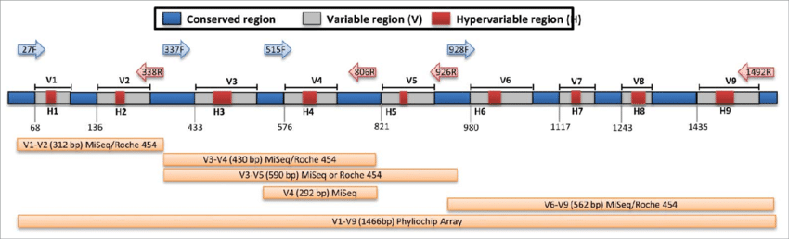
Sequencing sample
What am I amplifying? (16S, ITS)
Which regions? (Vx)
Which primers? (literature has quite a few)
*Choice of primers can lead to potential biases in the representation of the taxonomic units
How many reads I need? (10K, 50K, more?)
Which technology is the best? (do I need full length?)
What databases are available? (Silva or not?)

Slide 9
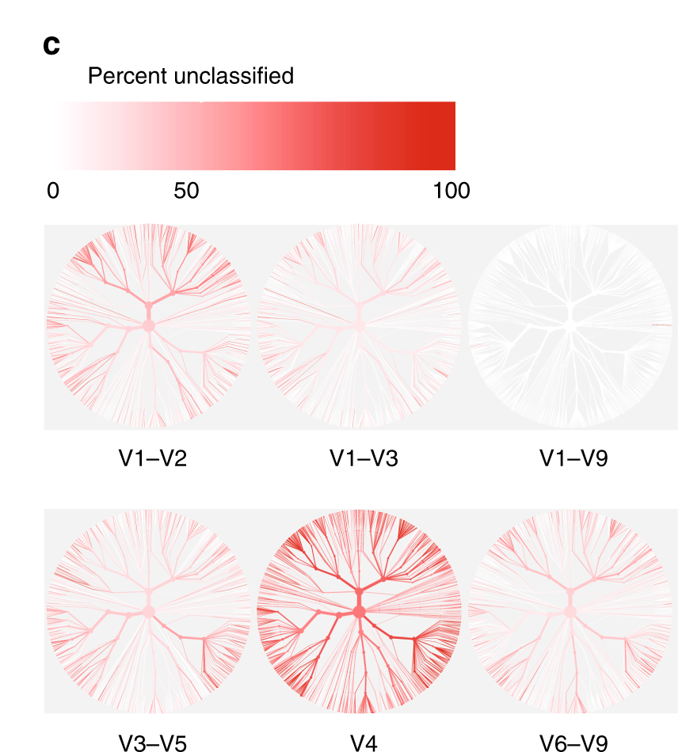
16S variable regions
V1–V2 region performed poorly at classifying sequences belonging to the phylum Proteobacteria
V3–V5 region performed poorly at classifying sequences belonging to the phylum Actinobacteria but great in identification of Klebsiella
Johnson et al. 2019

Slide 10
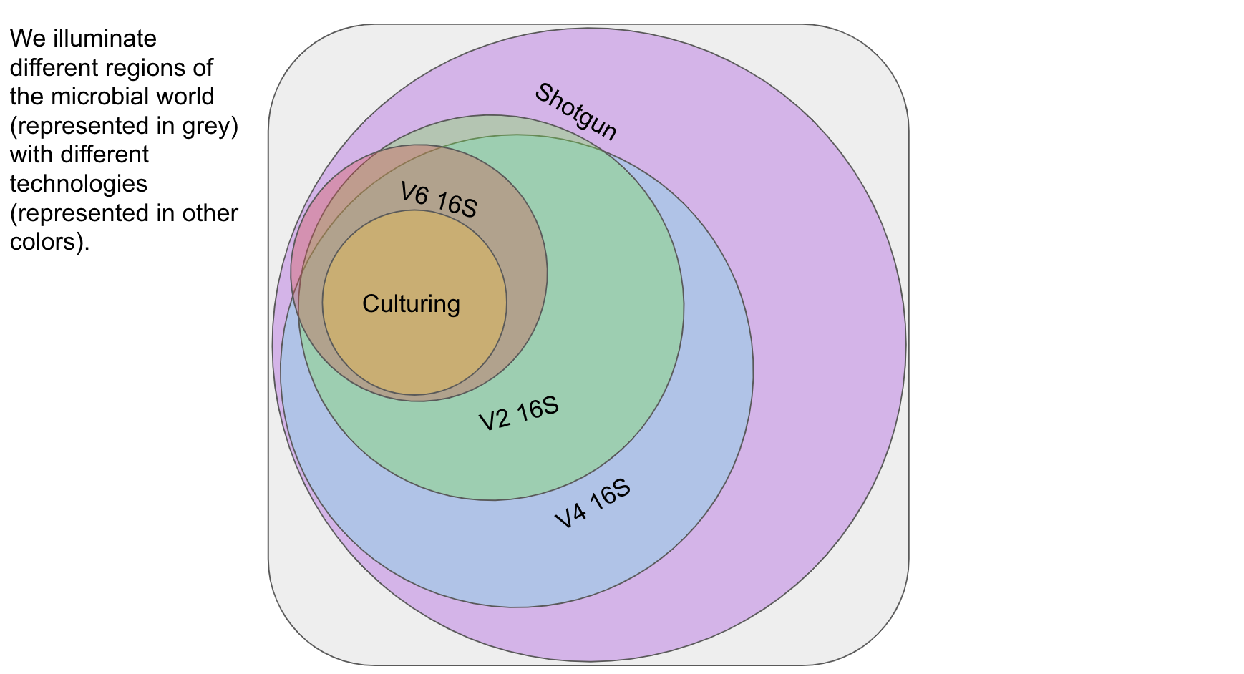
Resolution
https://docs.google.com/presentation/d/1lg6nH-M-Myr5KoYRDYDYDTuhl4YMs8_6yQ0xLcx0Shc/edit#slide=id.g4437732396_0_281

Slide 11
16S example workflow and associated challenges
Reads preprocessing
Sequencing sample
Map against bacterial database
Estimate error rates if mock community available
Estimate community composition
(*)
(*) These steps are more easily performed with a proper
metagenomics visualization package. (e.g. phyloseq, Metacoder in
Comparative analysis
(*)
Bioconductor)

Slide 12
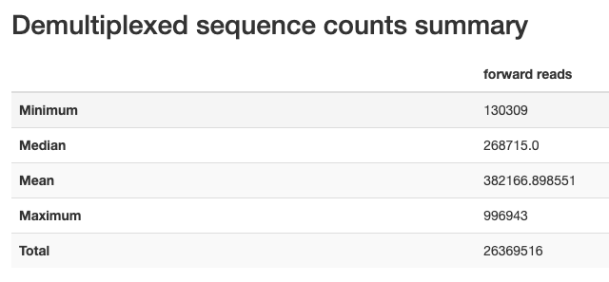
Reads preprocessing
How many reads I have per sample?

Slide 13
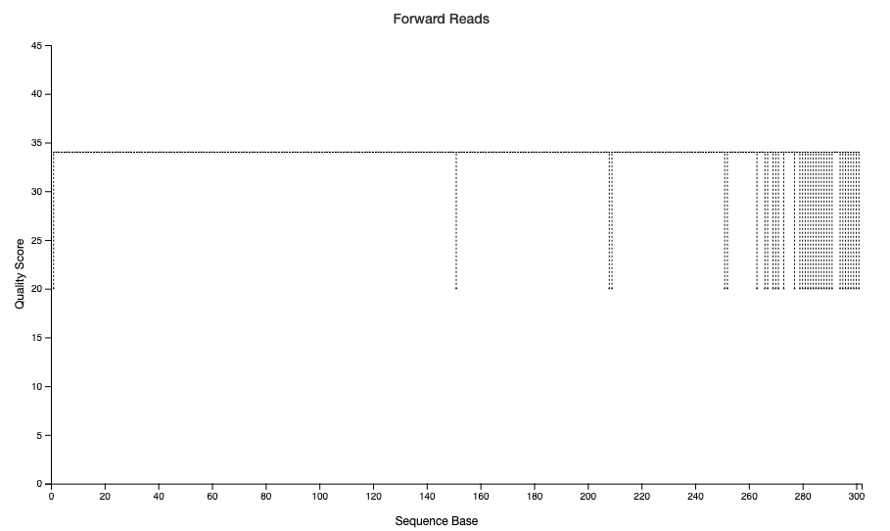
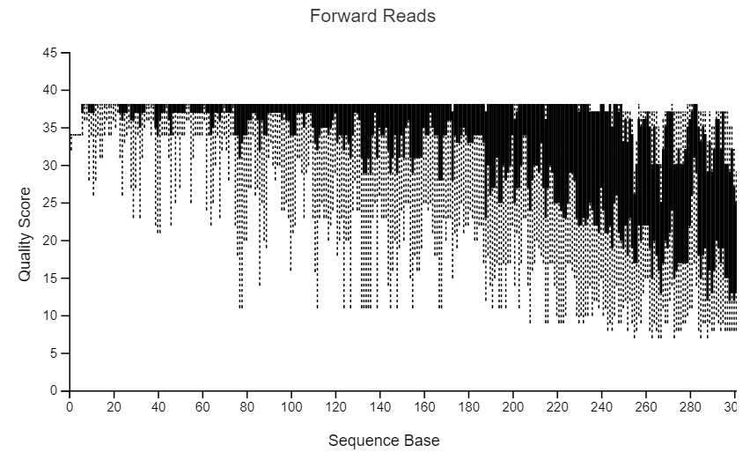
Reads preprocessing
How many reads I have per sample?
Are there issues with quality? (trimming by quality, length)

Slide 14
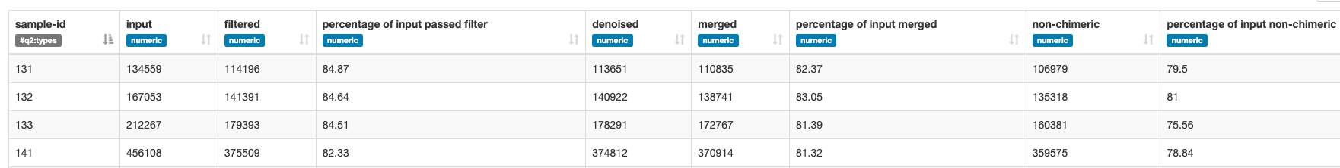
Reads preprocessing
How many reads I have per sample?
Are there issues with quality? (trimming by quality, length)
What filtering do I need? (adapter/other contamination)
How many reads I have after filtering?

Slide 15
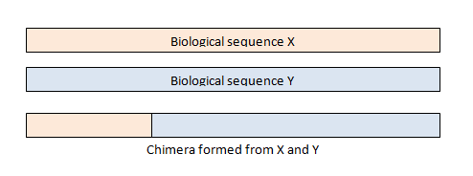
Reads preprocessing
How many reads I have per sample?
Are there issues with quality? (trimming by quality, length)
What filtering do I need? (adapter/other contamination)
How many reads I have after filtering?
What is the average accuracy?
As a general rule -> Discard reads that
do not match the primers, or
have ambiguous bases (Ns), or
paired reads that do not have perfect matching overlaps (mismatches or length difference)
chimeras

Slide 16
Reads preprocessing
Step | Description
Trim/Merge | Trim front or tail of sequences if low quality, remove adapters Merge paired end reads
Quality filter | Remove sequences by quality
Find unique/dereplicate/sort | Cluster exact same sequences, Cluster at > 99% id, this has the effect of removing most sequences with up to 1% errors, Sort by decreasing abundance. More abundant sequences make better centroids.
Cluster OTUs* | Discard all singletons, which are most likely chimeras, so set cluster size to >2
Make OTU table* | Cluster sequences to the same OTU by 97% sequence identity, using the plus strand
*optional

Slide 17
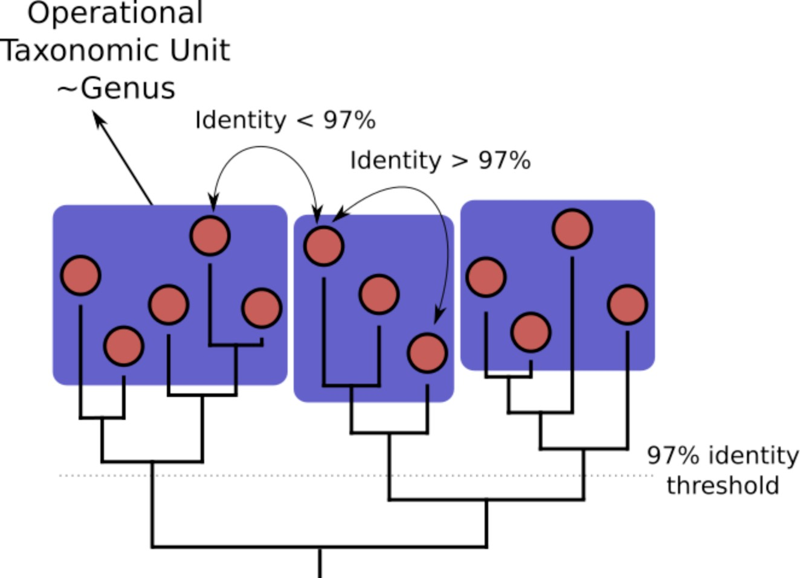
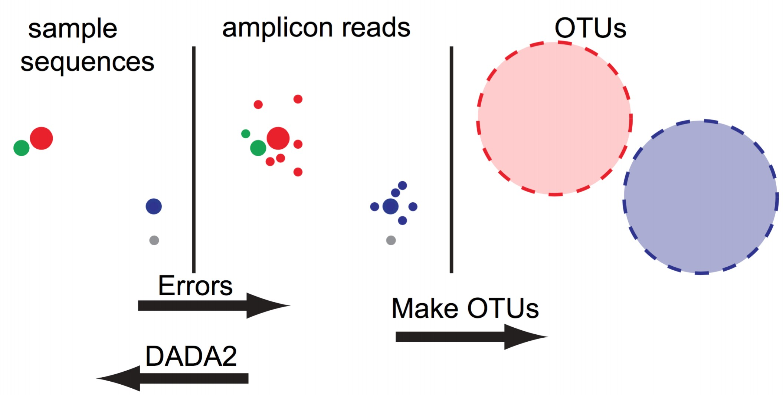
Operational Taxonomic Units (OTUs) vs Amplicon Sequence Variants (ASV)

Slide 18
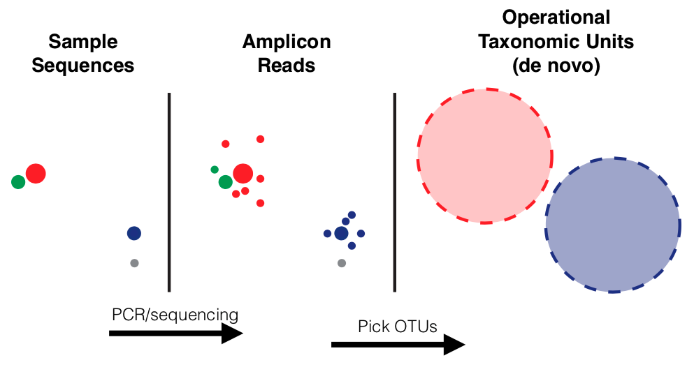
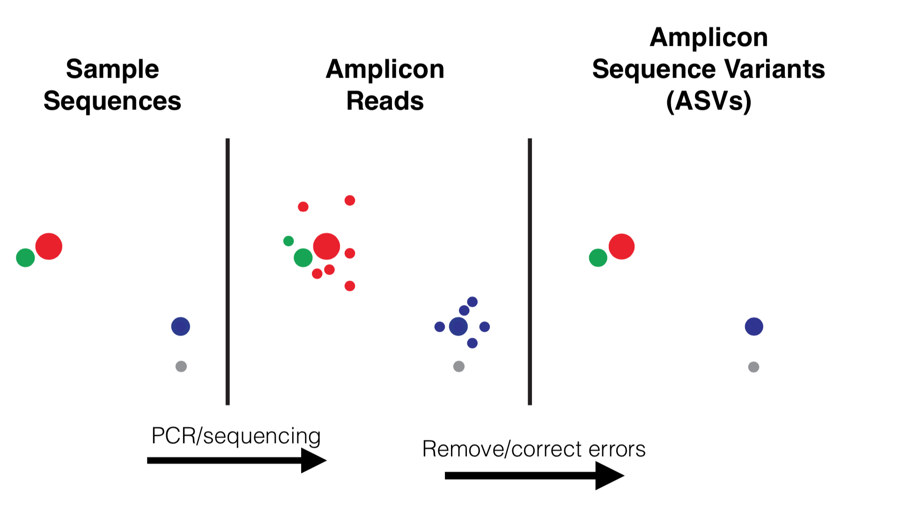
Operational Taxonomic Units (OTUs) vs Amplicon Sequence Variants (ASV)
By Dr. Benjamin Callahan - Dr. Benjamin Callahan- powerpoint presentation, CC BY-SA 4.0, https://commons.wikimedia.org/w/index.php?curid=95743551

Slide 19
Operational Taxonomic Units (OTUs) vs Amplicon Sequence Variants (ASV)
OTUs (e.g., Mothur) ASV (e.g., DADA2)
Result of sequence clustering (typically at 97% identity)
Only identical variants are clustered
Representative sequence obtained Each cluster is a unique variant
Cannot distinguish very subtle strains Can distinguish complex communities
Needs fewer reads Requires more reads
Can get away with imperfect data Needs virtually error-free sequences

Slide 20
Clustering
Reference-free - no reference database and creates the clusters entirely from observed sequences
Reference-based:
Closed-reference: uses a reference database of target gene sequences from known taxa and compares discovered sequences to them
Open-reference: open-reference clustering was developed, where sequences that can be quickly clustered to a reference database are clustered in a manner similar to closed-reference and remaining sequences are clustered in a manner similar to de novo
https://www.zymoresearch.com/blogs/

Slide 21
16S example workflow and associated challenges
Reads preprocessing
Sequencing sample
Map against bacterial database
Estimate error rates if mock community available
Estimate community composition
(*)
(*) These steps are more easily performed with a proper
metagenomics visualization package. (e.g. phyloseq, Metacoder in
Comparative analysis
(*)
Bioconductor)

Slide 22
Map against bacterial database
Which method will I use (e.g., ASV or OTU)?
What is known about the available databases?
Is it biased towards certain kingdoms or ranks?
Is there anything specific for my experiment?
E.g., very particular soil samples with large presence of certain organisms

Slide 23
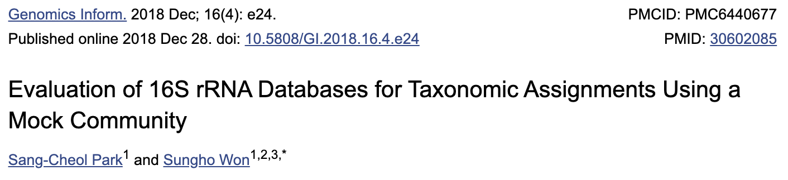
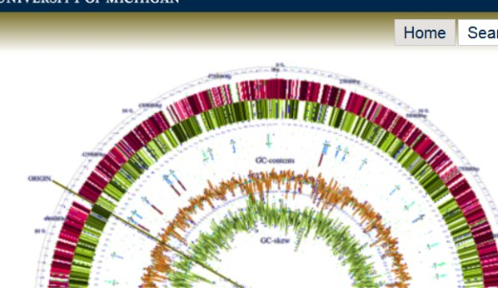

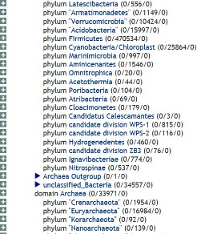
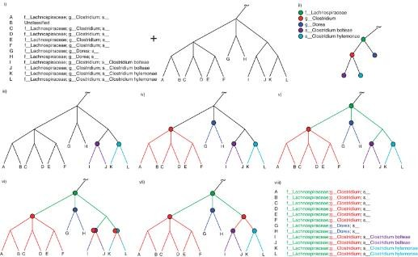

16S databases
EzBioCloud: Yoon et al.
PubMed (2017)
rrnDB: Stoddard et al.
NAR (2014)
RDP II: Cole et al.
NAR (2013)
SILVA: Quast et al.
NAR (2013)
GreenGenes: MacDonald et al. ISME J (2012)

Slide 24
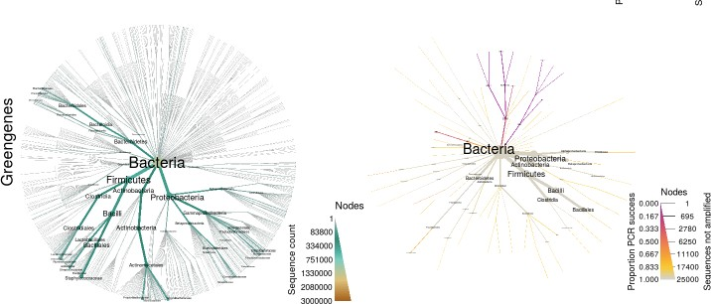
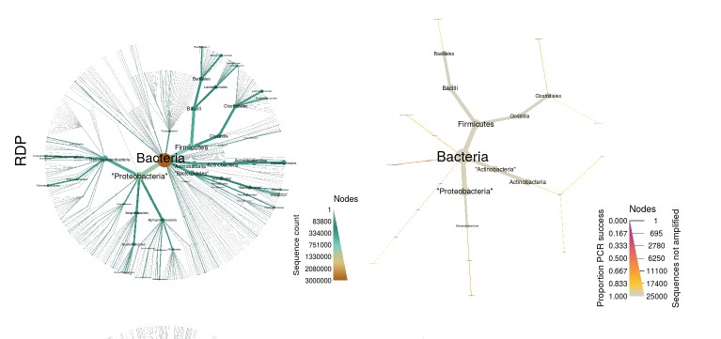
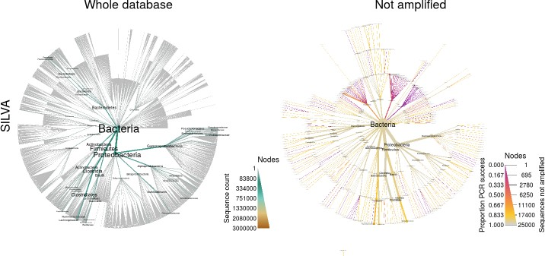
16S databases
•
•
Silva least biased and more complete
Greengenes and RDP selective against certain branches
RDP based on International Nucleotide Sequence Database Collaboration (INSDC) database – Fungi, Archea, Bacteria

Slide 25
16S example workflow and associated challenges
Reads preprocessing
Sequencing sample
Map against bacterial database
Estimate error rates if mock community available
Estimate community composition
(*)
(*) These steps are more easily performed with a proper
metagenomics visualization package. (e.g. phyloseq, Metacoder in
Comparative analysis
(*)
Bioconductor)

Slide 26
Estimate error rates if mock community available
Do I have a group truth available?
Do I need it?
How reliable the sequences are?
What is the error rate of my data?
What rank would be reasonable to achieve with such an error rate?

Slide 27
16S example workflow and associated challenges
Reads preprocessing
Sequencing sample
Map against bacterial database
Estimate error rates if mock community available
Estimate community composition
(*)
(*) These steps are more easily performed with a proper
metagenomics visualization package. (e.g. phyloseq, Metacoder in
Comparative analysis
(*)
Bioconductor)

Slide 28
Estimate community composition
Which tool?
Which filtering on the abundance data?
Is my community complete?
What is the diversity?
Do I need more data?

Slide 29
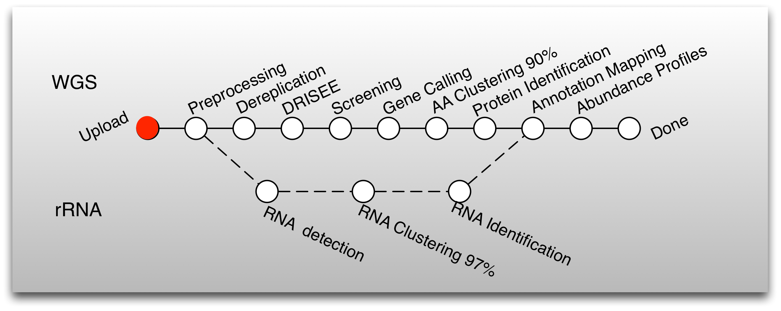
MG-RAST pipeline
All analysis is done on a web-server. You need to set up an account.
rRNA identification
A BLAT similarity search for the longest cluster representative is performed against the M5rna database which integrates SILVA(Pruesse et al. 2007), Greengenes(DeSantis et al. 2006), and RDP(Cole et al. 2003).

Slide 30
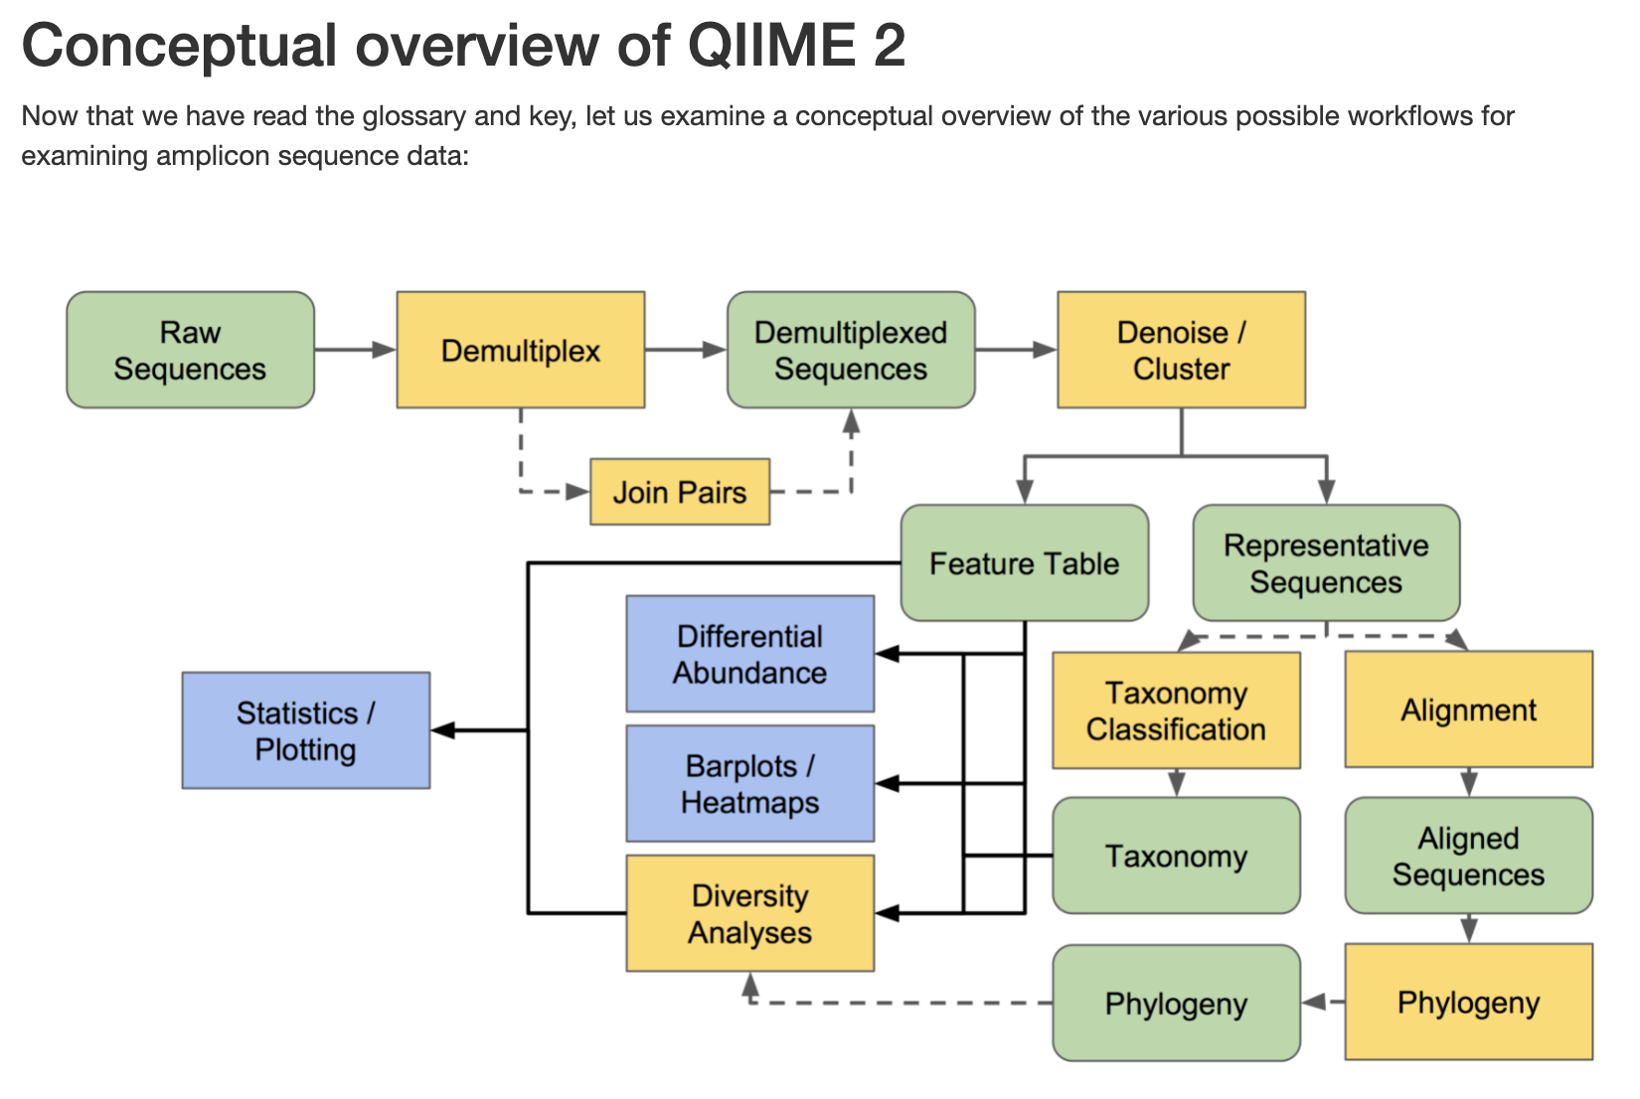
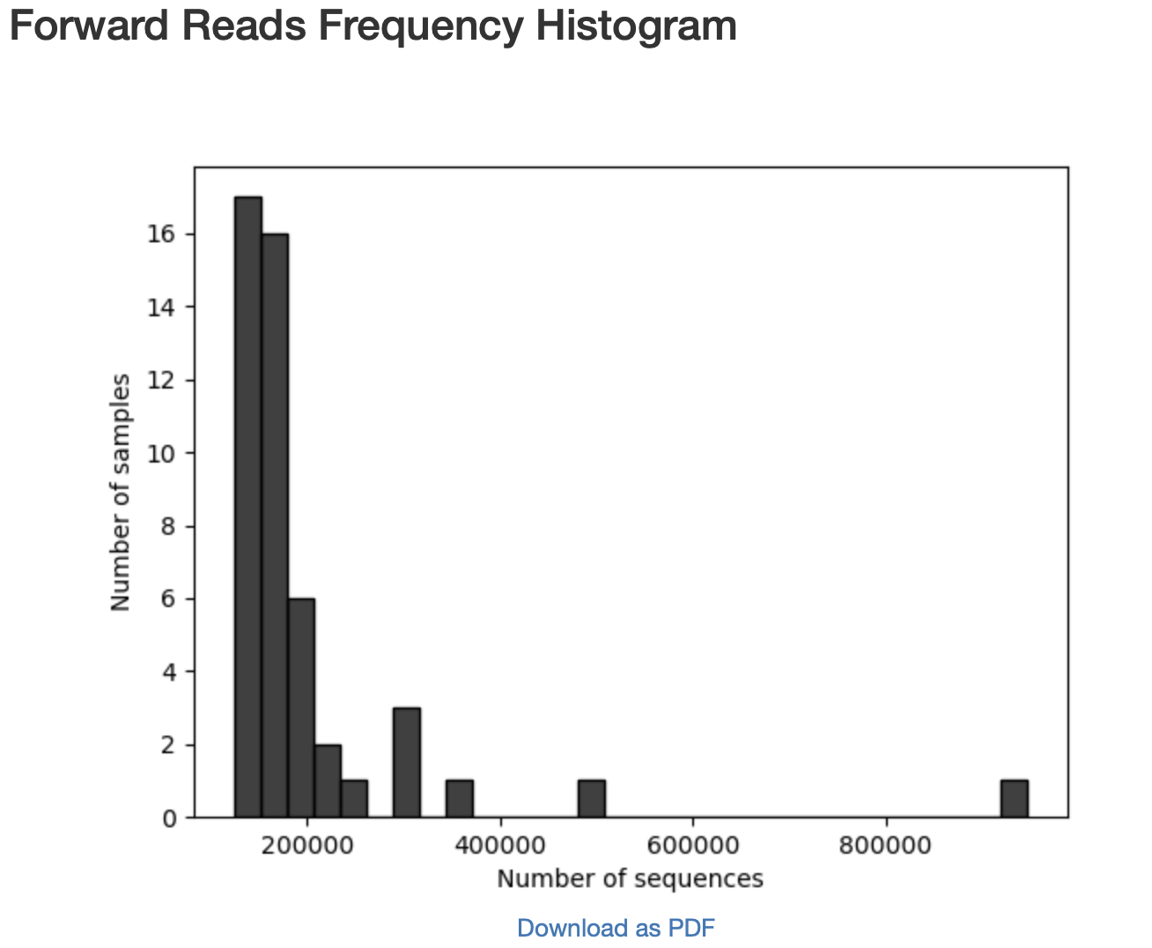
QIIME2
https://docs.qiime2.org/2022.2/tutorials/overview/
Per sample read counts
Read frequency histograms
Requires installation but can be installed on a linux, windows or mac.

Slide 31
QIIME2
https://docs.qiime2.org/2022.2/tutorials/overview/
Performed with DADA2 or Deblur
Output: ASVs
Percentage of denoised, non-chimeric reads
Requires installation but can be installed on a linux, windows or mac.

Slide 32
QIIME2
https://docs.qiime2.org/2022.2/tutorials/overview/
Use ASVs or classify the data onto OTUs with vsearch
Requires installation but can be installed on a linux, windows or mac.

Slide 33
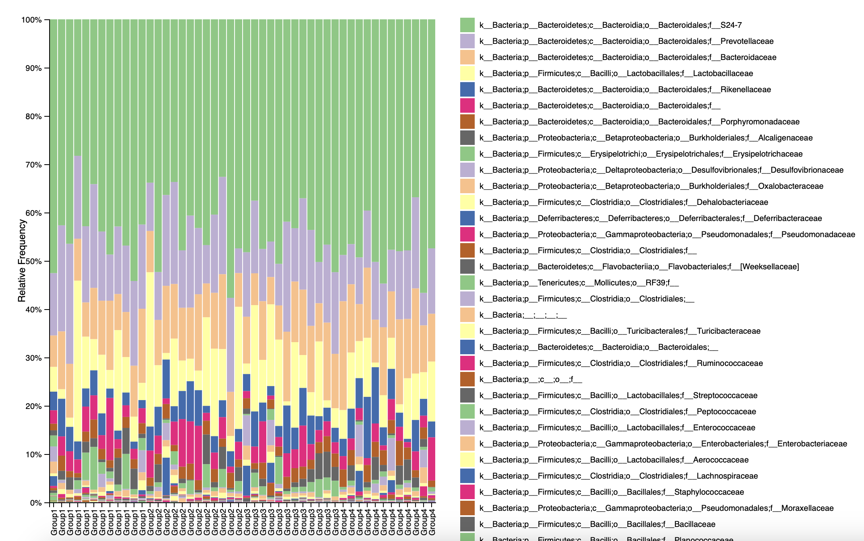
QIIME2
https://docs.qiime2.org/2022.2/tutorials/overview/
Perform taxonomic classification and alignment to produce phylogeny
Annotated features
Taxonomy bar graphs at different levels
Rooted and unrooted trees

Slide 34
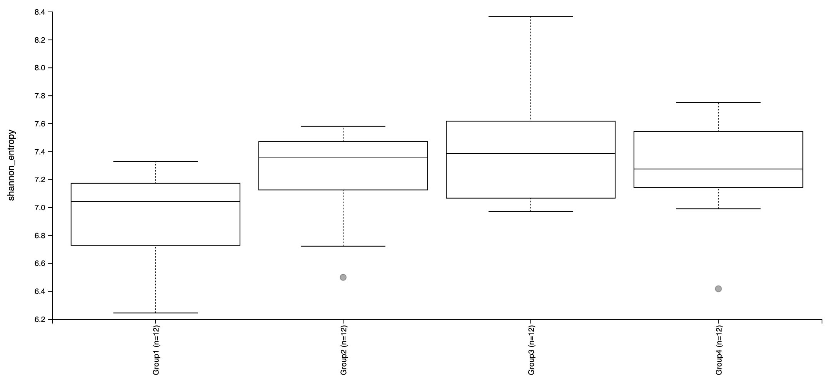
QIIME2
https://docs.qiime2.org/2022.2/tutorials/overview/
Alpha and beta diversity (Shannon diversity index and Jaccard and Bray Curtis diversity

Slide 35
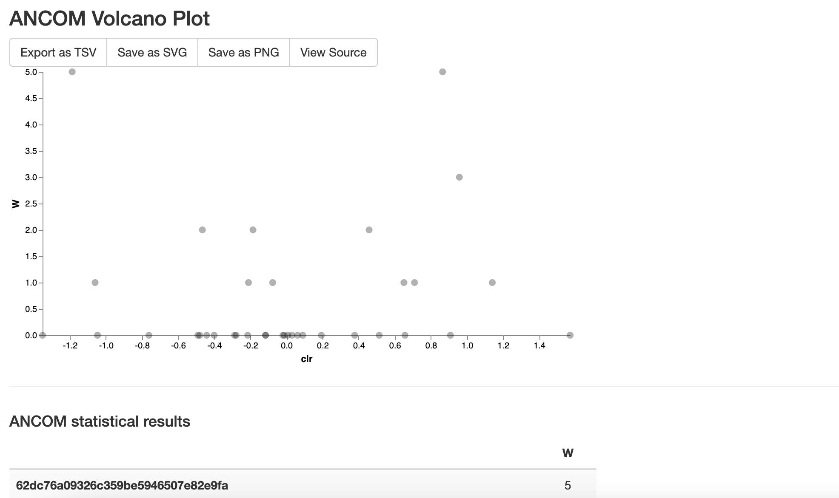
QIIME2
https://docs.qiime2.org/2022.2/tutorials/overview/
Differential abundance measured with ANCOM (Analysis of Microbial Composition)

Slide 36
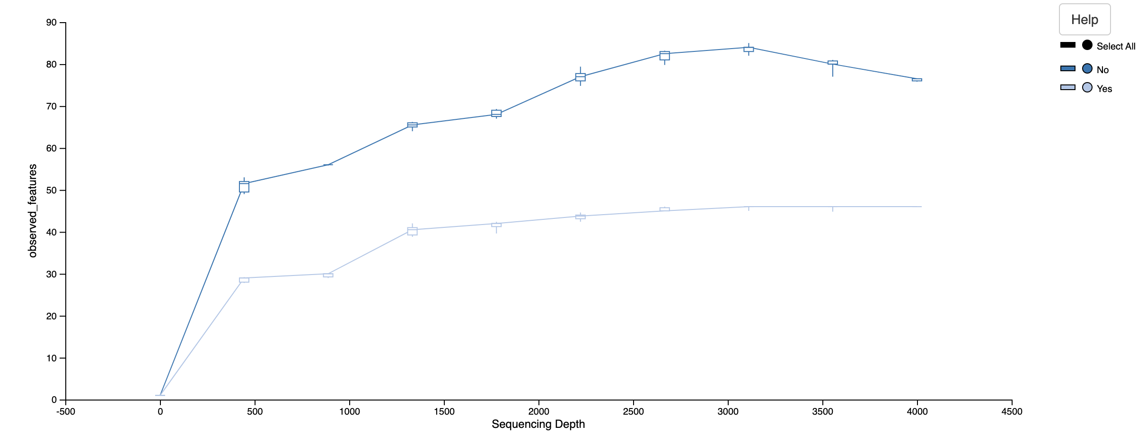
QIIME2
https://docs.qiime2.org/2022.2/tutorials/overview/
Rarefaction curve

Slide 37
A quick look at some other tools
USEARCH/UPARSE
Mothur
DADA2 within QIIME2
Divisive Amplicon Denoising Algorithm
Single program with minimal dependencies (read easy to install and setup)
Full R-based; easy to proceed with downstream analysis
Just a binary, super easy
Main clustering algorithm also an implementation of vsearch
Reimplementation of tried- and-tested algorithms (e.g., mapping, clustering)
Fast
High memory, multi-core server
High memory, multi-core server
Low memory, potentially parallelizable
Scalable (simple binary)
Not so much scalable (slows down with sample size)
Heavily aﬀected by errors; requires more reads
https://www.drive5.com/ usearch/manual/ uparse_pipeline.html
https://www.mothur.org/wiki/ MiSeq_SOP
https://benjjneb.github.io/ dada2/tutorial.html

Slide 38
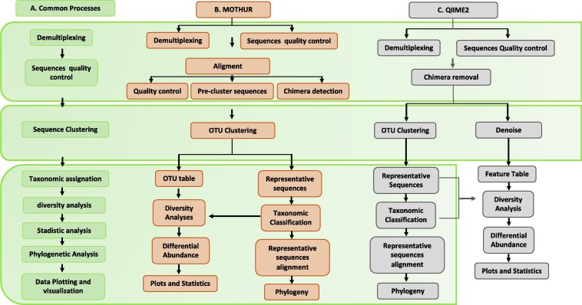
A quick look at some other tools
Santos et al. 2020 Computational methods for 16S metabarcoding studies using Nanopore sequencing data

Slide 39
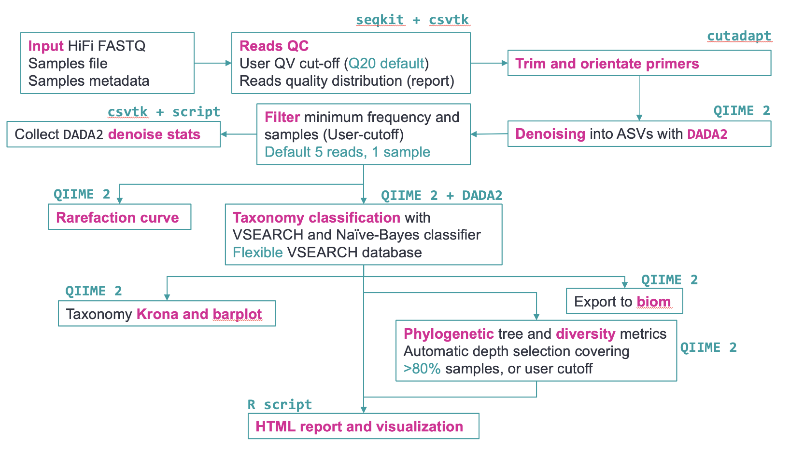
16S long read sequencing

Slide 40
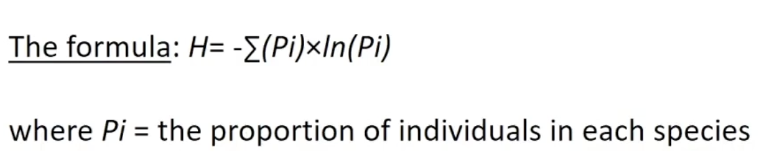
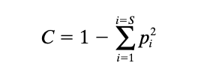
Example of statistical analysis – diversity estimates
Alpha Diversity
Shannon diversity index measures the diversity of species in a community.
Simpson diversity index measures the diversity of species in a community – dominance index
Beta Diversity
Bray–Curtis dissimilarity
- based on abundance/read count data
- differences in microbial abundances between two samples (e.g., at species level)
values are from 0 to 1
Jaccard distance
- based on presence or absence of species
- difference in microbial composition between two samples
0 means both samples share exact the same species
1 means both samples have no species in common
Mouillot et al. 1999

Slide 41
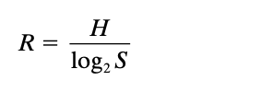
Example of statistical analysis – diversity estimates
Alpha Diversity
Shannon diversity index measures the diversity of species in a community.
Pielou’s evenness – also known as equitability
Shannon diversity divided by the logarithm of number of taxa
Beta Diversity
Bray–Curtis dissimilarity
- based on abundance/read count data
- differences in microbial abundances between two samples (e.g., at species level)
values are from 0 to 1
Jaccard distance
- based on presence or absence of species
- difference in microbial composition between two samples
0 means both samples share exact the same species
1 means both samples have no species in common
Mouillot et al. 1999

Slide 42
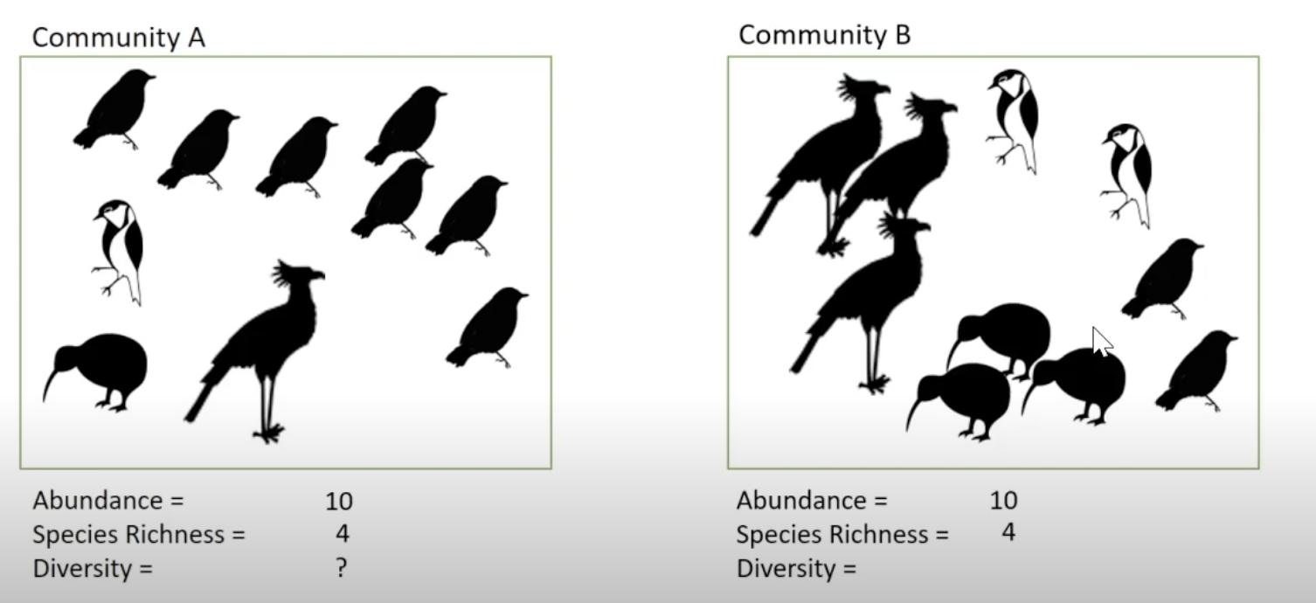
Shannon vs Simpson’s diversity Index

Slide 43
Simpson’s diversity Index
Species | n | pi | pi²
A | 7 | 0.7 | 0.49
B | 1 | 0.1 | 0.01
C | 1 | 0.1 | 0.01
D | 1 | 0.1 | 0.01
Total | 10 |  | 0.52
C = 1 – 0.52 = 0.48

Slide 44
Simpson’s diversity Index
Species | n | pi | pi²
A | 2 | 0.2 | 0.04
B | 2 | 0.2 | 0.04
C | 3 | 0.3 | 0.09
D | 3 | 0.3 | 0.09
Total | 10 |  | 0.26
C = 1 – 0.26 = 0.74

Slide 45
Shannon diversity Index
Species | n | Pi | Ln(Pi) | Pi*Ln(Pi)
A | 7 | 0.7 | -0.35 | -0.245
B | 1 | 0.1 | -2.3 | -0.23
C | 1 | 0.1 | -2.3 | -0.23
D | 1 | 0.1 | -2.3 | -0.23
Total | 10 |  |  | -0.935
H = 0.935

Slide 46
Shannon diversity Index
Species | n | Pi | Ln(Pi) | Pi*Ln(Pi)
A | 2 | 0.2 | -1.61 | -0.322
B | 2 | 0.2 | -1.61 | -0.322
C | 3 | 0.3 | -1.2 | -0.361
D | 3 | 0.3 | -1.2 | -0.361
Total | 10 |  |  | -1.366
H = 1.366

Slide 47
16S example workflow and associated challenges
Reads preprocessing
Sequencing sample
Map against bacterial database
Estimate error rates if mock community available
Estimate community composition
(*)
(*) These steps are more easily performed with a proper
metagenomics visualization package. (e.g. phyloseq, Metacoder in
Comparative analysis
(*)
Bioconductor)

Slide 48
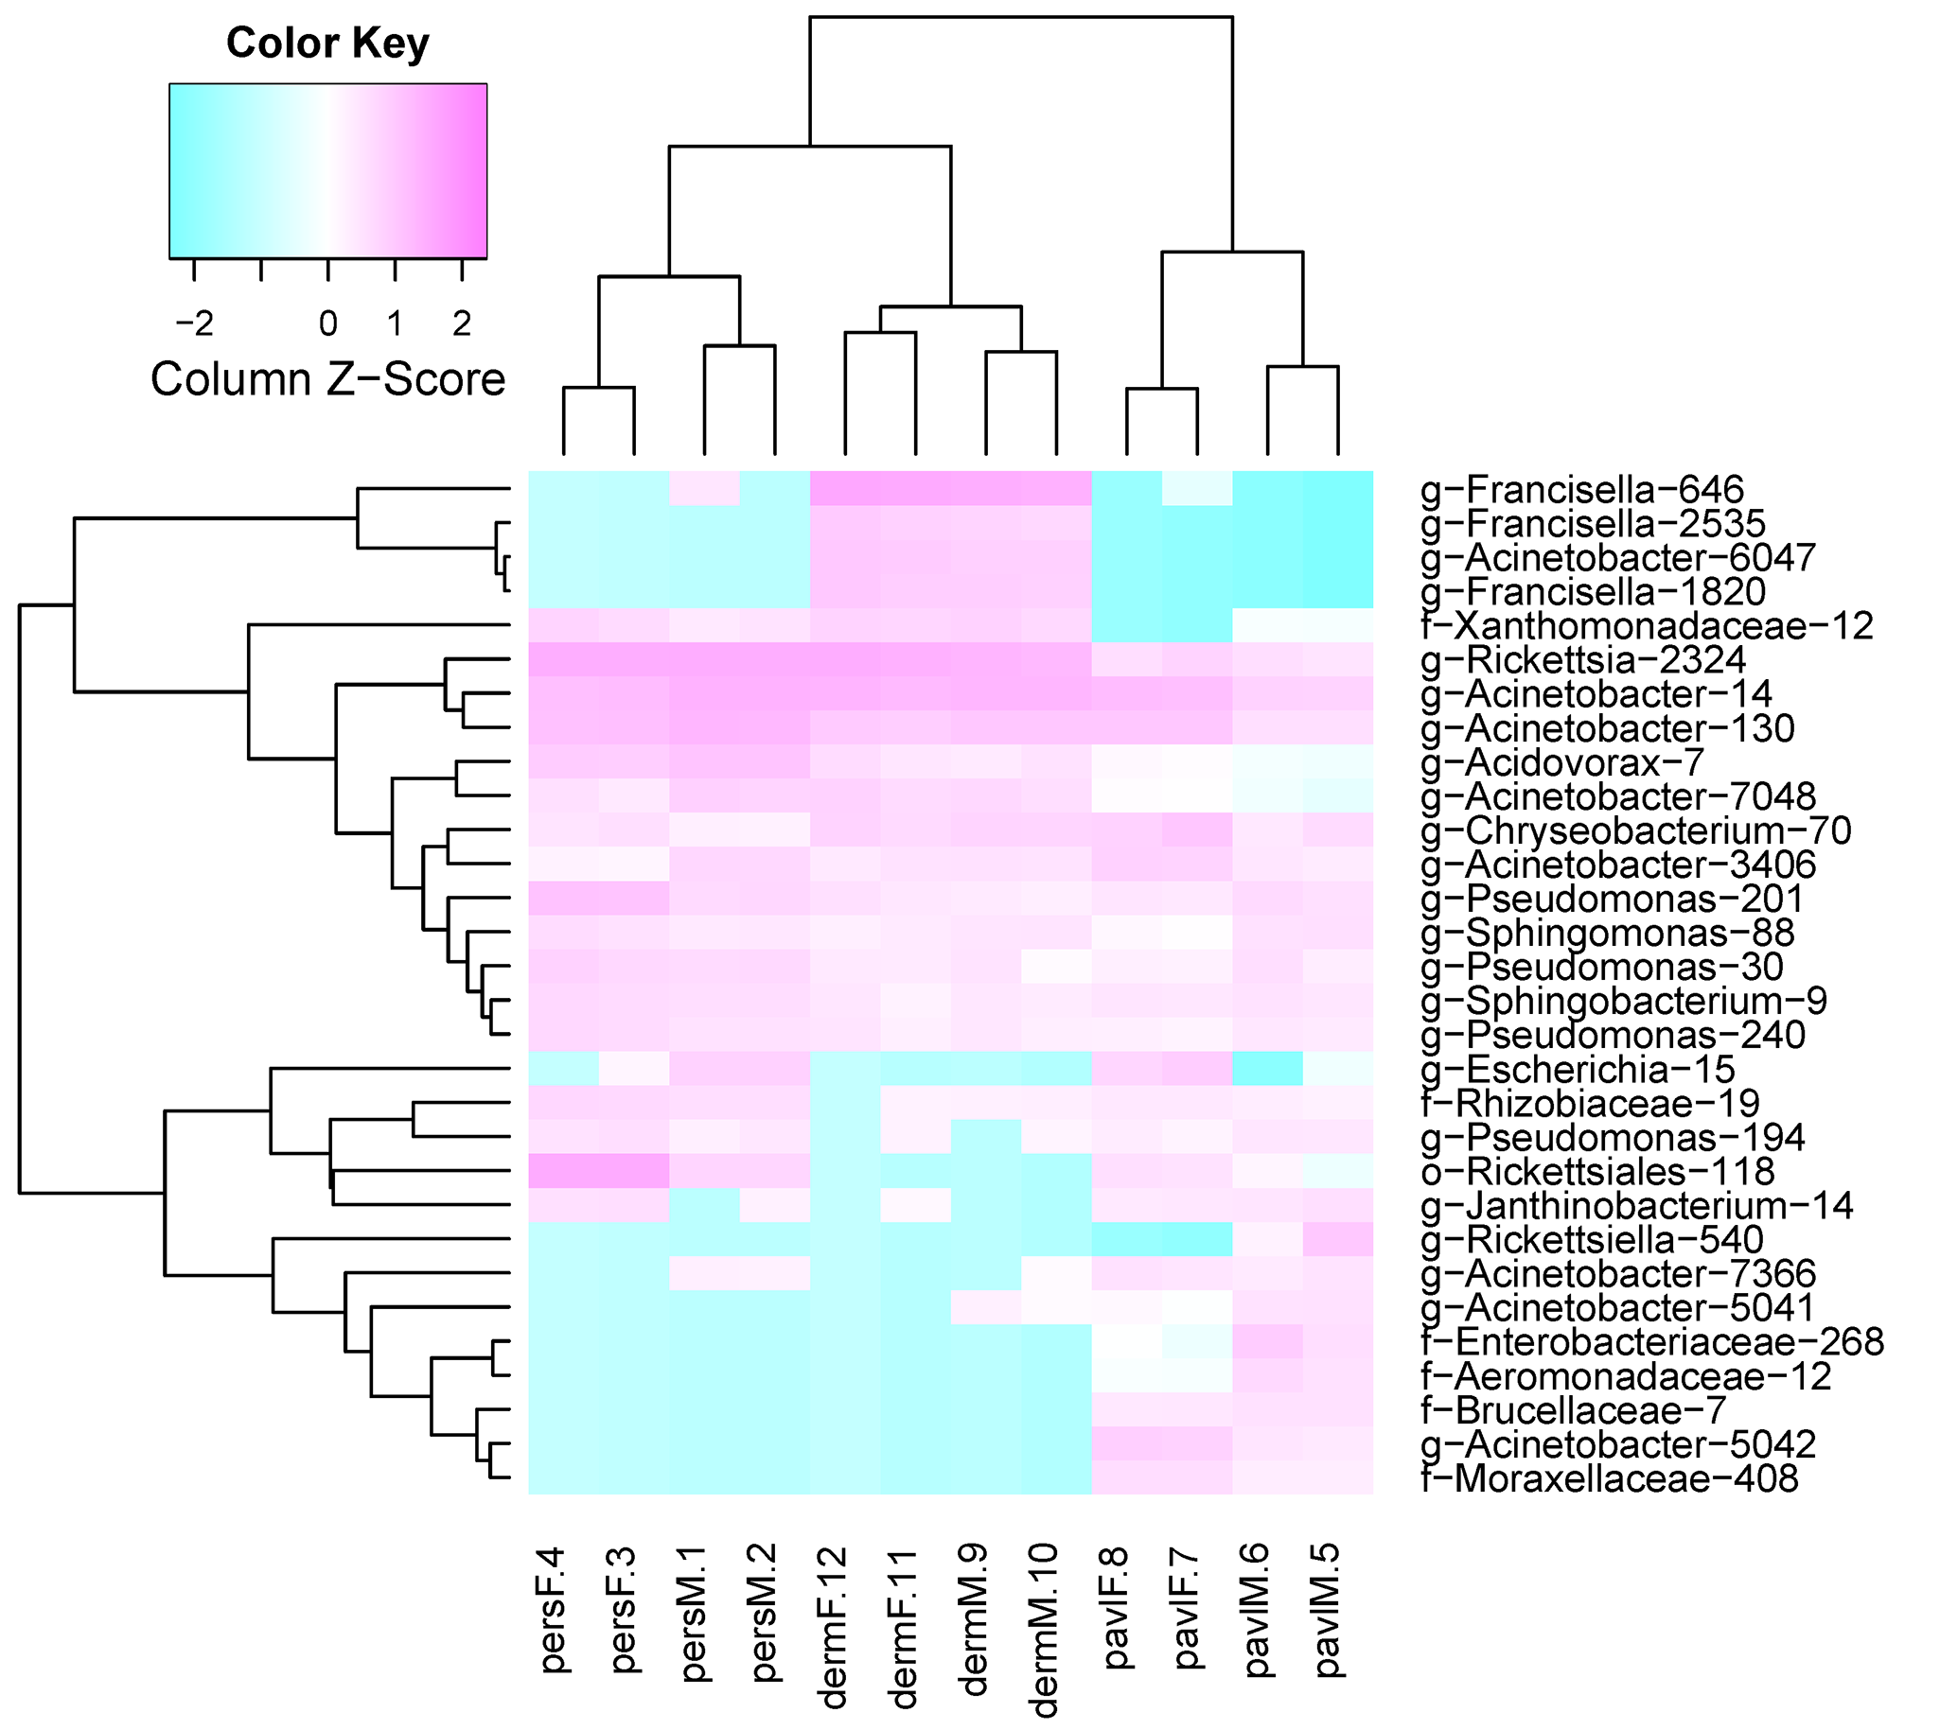
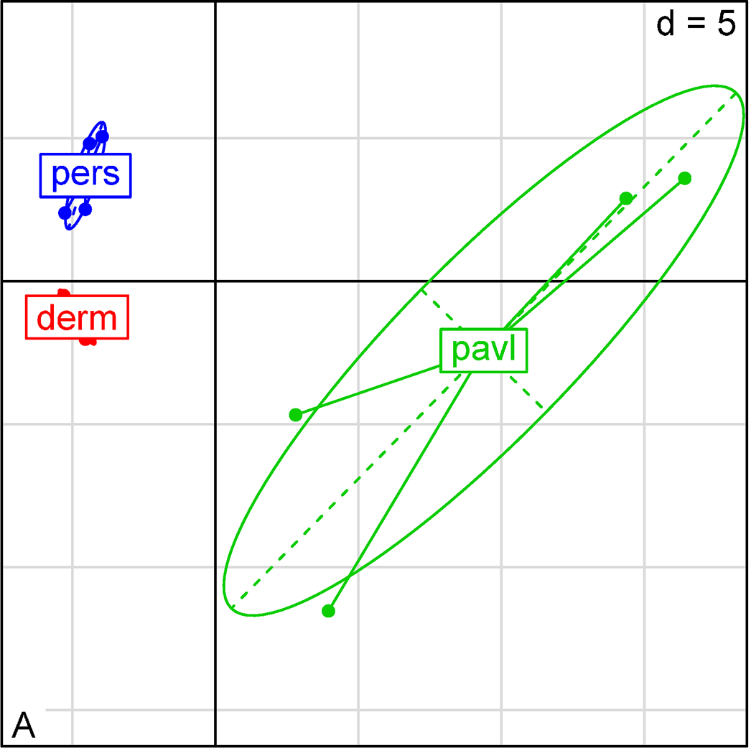
Comparative analysis: is there a host phenotype/environmental condition - community composition association?
Based on euclidean distance method for log-scaled in-sample taxon share values
(pink – higher OTU abundance)
Beta diversity – UniFRAC distance
Ixodes persulcatus
Ixodes pavlovskyi
Dermacentor reticulatus
Kurilshikov et al. 2015

Slide 49
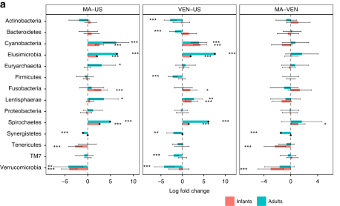
Comparative analysis: is there a host phenotype/environmental condition - community composition association?
Analysis of Microbial Composition – a method for testing for differential abundance
ANCOMBC
The method
is based on compositional log-ratios
incorporates sampling fraction into the model which is estimated as the ratio of the library size to the microbial load.
controls for the false discovery rate
p-values corrected with with Bonferroni Hochberg correction method

Slide 50
Technical details
File formats
Processed data
BIOM format

Slide 51
Processed 16S data
•
The outcome of processed data consists of 3 information:
OTUs abundance matrix
OTU classification
Sample metadata

Slide 52
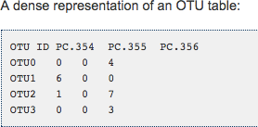
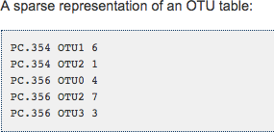
OTU abundance matrix can be dense or sparse
Dense matrices contain zeros for OTUs not observed in certain samples
Sparse do not; lot of space saved

Slide 53
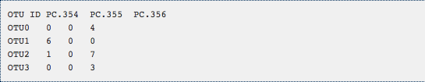
Taxonomic classification
•
Can be contained in the OTU matrix…
Taxonomy
Bacteria;Firmicutes;Bacilli; Bacteria;Firmicutes;Bacilli; Bacteria;"Proteobacteria";Gammaproteobacteria
Bacteria;"Proteobacteria";Gammaproteobacteria
•
Or be stored in a different file
OTU
Size
Taxonomy
Otu0001
2024
Bacteria;Firmicutes;Bacilli;Bacillales;Bacillaceae_1;Bacillus;
Otu0002
1552
Bacteria;Firmicutes;Bacilli;Bacillales;Staphylococcaceae;Staphylococcus;
Otu0003
1207
Bacteria;Firmicutes;Bacilli;Bacillales;Listeriaceae;Listeria;
Otu0004
874
Bacteria;Firmicutes;Bacilli;Lactobacillales;Lactobacillaceae;Lactobacillus;
Otu0005
752
Bacteria;Firmicutes;Bacilli;Lactobacillales;Enterococcaceae;Enterococcus;

Slide 54
Sample Infromation
•
Typical design matrix
Name
Technology [Factor]
Group [Factor]
post1 Illumina
post
post2
Illumina
post
post3 Illumina
post
pre1
Illumina
pre
pre2
Illumina
pre
pre3
Illumina
pre

Slide 55

Practical
2 individuals: with/without antibiotics
396 time points (here 5 times points)
Earth Microbiome Project
sequenced hypervariable region 4 (V4) 16S rRNA
analysis of human microbiome samples
Original study is from Copraso et al. 2011
Analysed with Quantitative Insights Into Microbial Ecology (QIIME2)
tongue
gut
right palm
left palm
https://pubmed.ncbi.nlm.nih.gov/21624126/

Slide 56
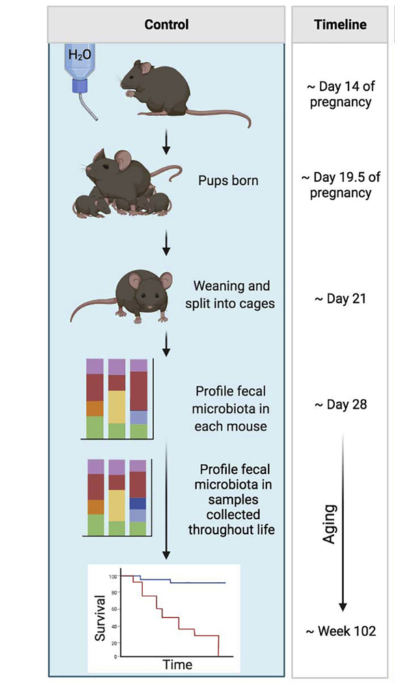
Practical
Schloss mice
sequenced hypervariable region 4 (V4) 16S rRNA
analysis of mice gut microbiome post-weaning
Original study is from Schloss et al. 2012
Analysed with Mothur
https://www.tandfonline.com/doi/full/10.4161/gmic.21008

Slide 57
Lets do some work!
Go to https://gitlab.bfabric.org/genomics-courses/bio638_2024_june
Scroll to QIIME2 analysis google colab tutorials

